Slide 1


Python OOP

Slide 2

What is OOP(Object Oriented Programming)?!
Object-oriented programming (OOP) is a computer programming model that organizes software design around data, or objects, rather than functions and logic. An object can be defined as a data field that has unique attributes and behavior.

Slide 3
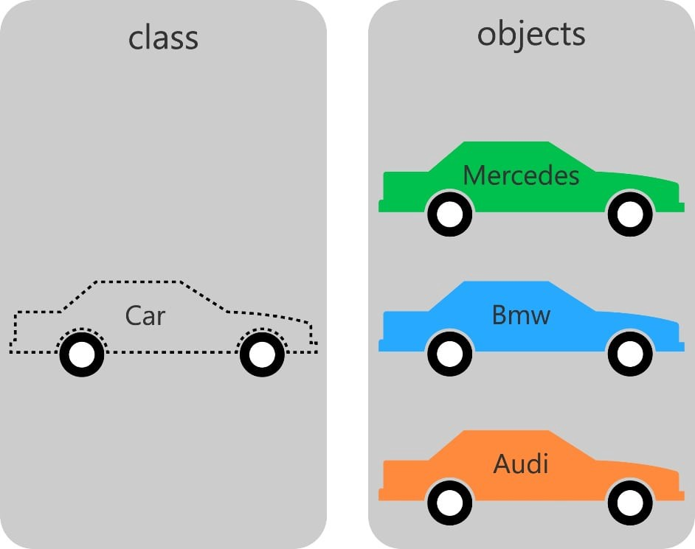

Slide 4


OOP Principles!?
Encapsulation (No mechanism)
Inheritance
Abstraction (Not natively supported,
need abc module imported)
Polymorphism

Slide 5
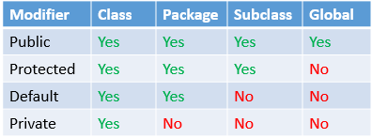
Encapsulation
The implementation and state of each object are privately held inside a defined boundary, or class. Other objects do not have access to this class or the authority to make changes but are only able to call a list of public functions, or methods. This characteristic of data hiding provides greater program security and avoids unintended data corruption.
!!!Python doesn't have any mechanism that effectively restricts access to any instance variable or method. Python prescribes a convention of prefixing the name of the variable/method with single or double underscore to emulate the behavior of protected and private access specifiers.!!!

Slide 6
Inheritance
Relationships and subclasses between objects can be assigned, allowing developers to reuse a common logic while still maintaining a unique hierarchy. This property of OOP forces a more thorough data analysis, reduces development time and ensures a higher level of accuracy.
When a class inherits another class it only gets ìt`s non-private members (public or protected).

Slide 7
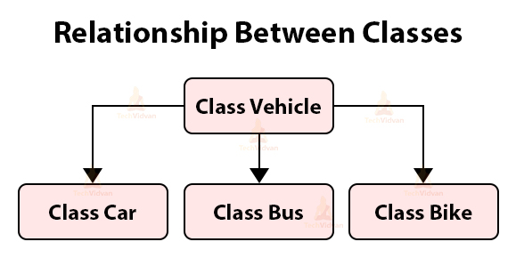

Slide 8
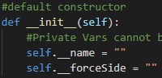
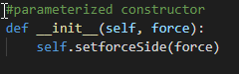
Constructors
Constructors are generally used for instantiating an object.The task of constructors is to initialize(assign values) to the data members of the class when an object of class is created. In Python the __init__() method is called the constructor and is always called when an object is created.
default constructor :The default constructor is simple constructor which doesn’t accept any arguments. It’s definition has only one argument which is a reference to the instance being constructed.
parameterized constructor :constructor with parameters is known as parameterized constructor. The parameterized constructor take its first argument as a reference to the instance being constructed known as self and the rest of the arguments are provided by the programmer.

Slide 9
Abstraction
Objects only reveal internal mechanisms that are relevant for the use of other objects, hiding any unnecessary implementation code. This concept helps developers more easily make changes and additions over time.

Slide 10
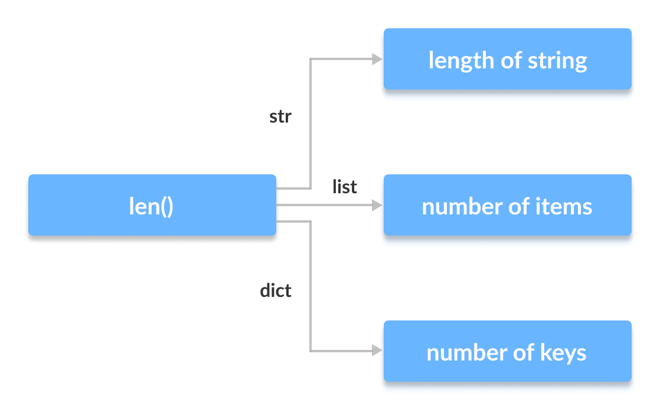
Polymorphism
Objects can take on more than one form depending on the context. The program will determine which meaning or usage is necessary for each execution of that object, cutting down the need to duplicate code.

Slide 11
Bonus lecture:
Multithreading

Slide 12

What is multithreading ?!
In computer architecture, multithreading is the ability of a central processing unit (CPU) (or a single core in a multi-core processor) to provide multiple threads of execution concurrently, supported by the operating system.

Slide 13
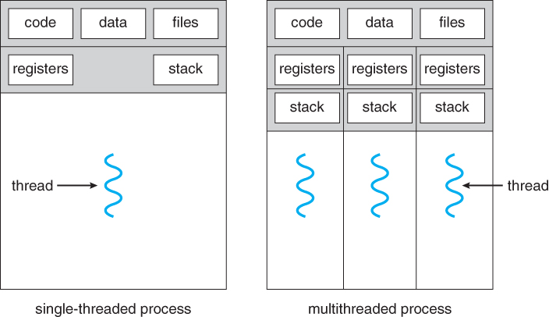

Slide 14
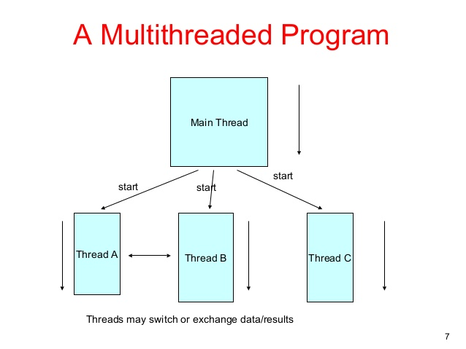

Slide 15
Thank you for your attention!

